Slide 1
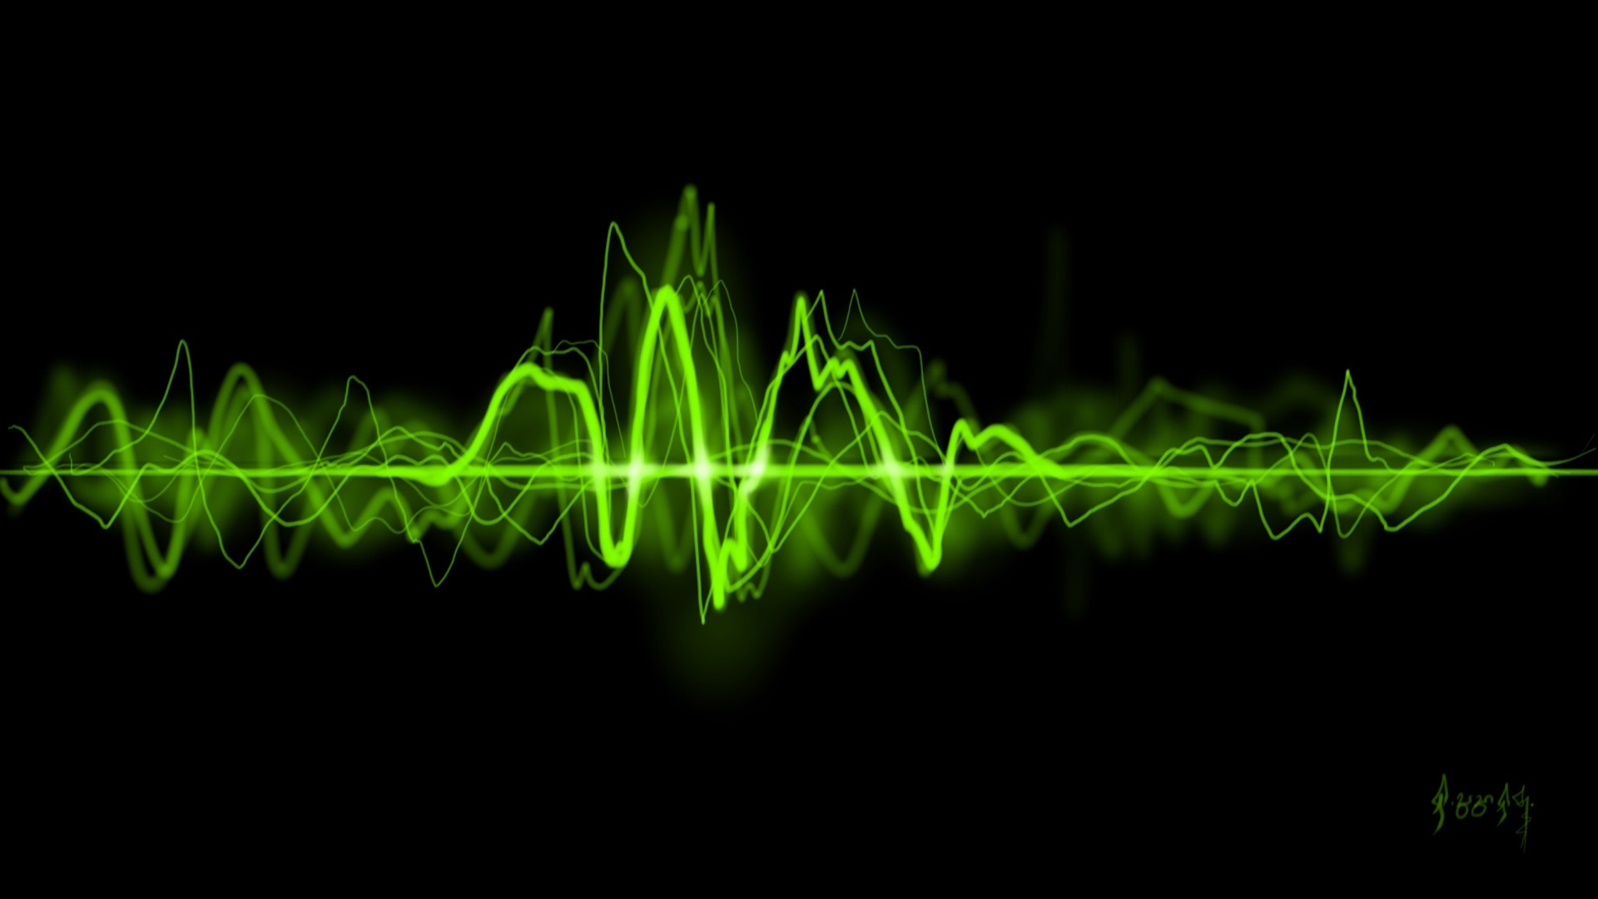
Audio Visualization

Slide 2
Project Goal
Explore audio I/O
PyAudio
Explore data visualization
PyQtGraph
Explore Python front-end development
PyQt5

Slide 3
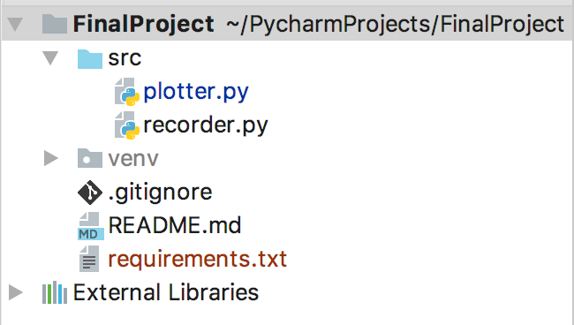
Project Structure
Python 3.6
Git

Slide 4
Recorder
import threading import pyaudio import atexit import numpy
# On creation, records audio through the microphone
class Recorder(object):

Slide 5
Recorder
def __init__(self, rate=4000, chunksize=1024):
# Initialize audio variables and pyaudio
self.rate = rate
self.chunksize = chunksize
self.pyaudio_instance = pyaudio.PyAudio()
self.stream = self.pyaudio_instance.open(format=pyaudio.paInt16,
channels=1,
rate=self.rate,
input=True,
frames_per_buffer=self.chunksize,
stream_callback=self.new_frame)
self.frames = []
# Initialize multithreading routines
self.lock = threading.Lock()
self.stop = False
atexit.register(self.close)

Slide 6
Recorder
# Callback method when a new audio frame is recorded
def new_frame(self, data, frame_count, time_info, status):
data = numpy.fromstring(data, 'int16')
with self.lock:
self.frames.append(data)
if self.stop:
return None, pyaudio.paComplete
return None, pyaudio.paContinue

Slide 7
Recorder
# Return filled audio frames, and re-initialize audio frames
def get_frames(self):
with self.lock:
frames = self.frames
self.frames = []
return frames

Slide 8
Recorder
def start(self):
self.stream.start_stream()
# Stop recording, close the stream, terminate pyaudio
def close(self):
with self.lock:
self.stop = True
self.stream.close()
self.pyaudio_instance.terminate()

Slide 9
Plotter
from collections import deque
from pyqtgraph.Qt import QtGui, QtCore
import pyqtgraph
from recorder import Recorder
import audioop
# Plots sound graph from microphone
class Plotter(QtGui.QWidget):
RMS_QUEUE_SIZE = 100 # RMS queue size in timer intervals
TIMER_INTERVAL = 100 # Timer interval in milliseconds

Slide 10
Plotter
def __init__(self, width, height):
QtGui.QWidget.__init__(self)
# Initialize the user interface
graphics_window = pyqtgraph.GraphicsWindow()
layout = QtGui.QGridLayout()
self.setLayout(layout)
self.resize(width, height)
self.setWindowTitle('PyAudio Demo')
# Create plots
pyqtgraph.setConfigOptions(antialias=True)
oscilloscope_widget = pyqtgraph.PlotWidget()
oscilloscope_curve = oscilloscope_widget.plot(pen='y')
oscilloscope_widget.setXRange(0,1050) # TODO Extract constants when measurement units are identified
oscilloscope_widget.setYRange(-50000,50000)
self.oscilloscope_curve = oscilloscope_curve
volume_widget = pyqtgraph.PlotWidget()
volume_curve = volume_widget.plot(pen='y')
volume_widget.setYRange(0, 16000)
volume_widget.setXRange(0, Plotter.RMS_QUEUE_SIZE)
self.volume_curve = volume_curve

Slide 11
Plotter
# Create other widgets
layout.addWidget(oscilloscope_widget, 0, 0)
layout.addWidget(volume_widget,0, 1)
self.show()
timer = QtCore.QTimer()
timer.timeout.connect(self.handle_new_data)
timer.start(Plotter.TIMER_INTERVAL)
self.timer = timer
# Initialize the recorder
recorder = Recorder()
recorder.start()
self.recorder = recorder
self.rms_deque = deque(maxlen=Plotter.RMS_QUEUE_SIZE)

Slide 12
Plotter
# Handle callback data from recorder
def handle_new_data(self):
frames = self.recorder.get_frames()
if len(frames) > 0:
current_frame = frames[-1]
rms = audioop.rms(current_frame,2)
self.rms_deque.append(rms)
self.oscilloscope_curve.setData(current_frame)
self.volume_curve.setData(list(self.rms_deque))

Slide 13
Plotter
# Start Qt event loop unless running in interactive mode or using pyside.
if __name__ == '__main__':
import sys
if (sys.flags.interactive != 1) or not hasattr(QtCore, 'PYQT_VERSION'):
app = QtGui.QApplication(sys.argv)
screen_rect = app.desktop().screenGeometry()
window = Plotter(screen_rect.width(), screen_rect.height())
sys.exit(app.exec_())

